Slide 1

CATALOGUED PROCEDURE AND
DATASET OVERRIDING
PRESENTED BY
V.ASHWIN KUMAR

Slide 2
Catalogued Procedure:
When the procedure is separated out from the JCL and coded in a different dataset, it is called a Catalogued Procedure.
We achieve modularity and Reusability using
Catalogued Procedures.

Slide 3
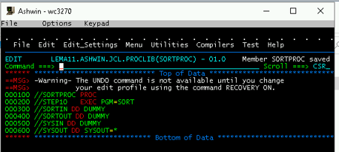
Sort Procedure:

Slide 4
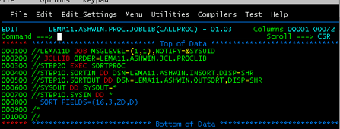
Procedure Call with Dataset Overriding:

Slide 5
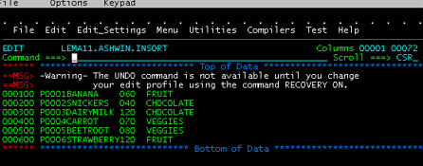
Input file :

Slide 6
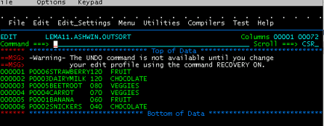
Output file:

Slide 7
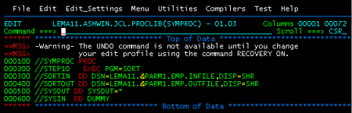
Procedure with Symbolic Parameters :

Slide 8
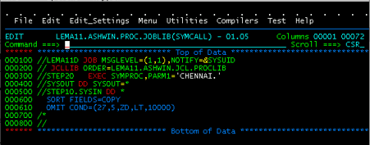
Procedure Call:

Slide 9
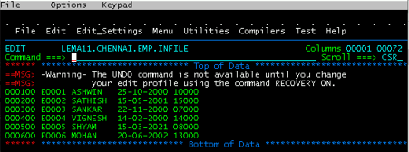
Input file1:

Slide 10
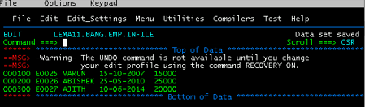
Input file2 :

Slide 11
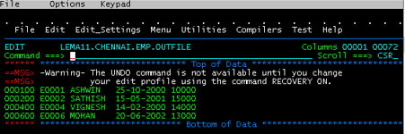
Output file:

Slide 12



Thank you
Reimagine technology to
accelerate your business
www.htcinc.com
www.caretech.com
www.ciber.com

